Slide 1
“Welcome to the Sunrise City and Sidney Public Schools”

Slide 2
What is a Professional Learning Community?

Slide 3
It is confronting the questions most schools face. It is not, “What do we need to know in order to improve?” but rather, “Will we turn what we already know into action?”
Source: DuFour, et al, Learning by Doing

Slide 4
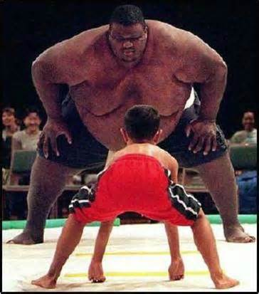
Notes:
AS I REFLECT ON THE SCORES, IT IS BOTH A CHALLENGE AND OPPORTUNITY. WE CAN WORK TO:
CREATE A COMMON FOCUS WHERE NEEDED
CONTINUE TO PUSH HIGH EXPECTATIONS FOR STUDENTS AND STAFF
CONTINUE TO REFINE AND DEVELOP A RIGOROUS CURRICULUM IN ALL AREAS
AND, MEASURE AND EVALUATE PROGRESS

Slide 5
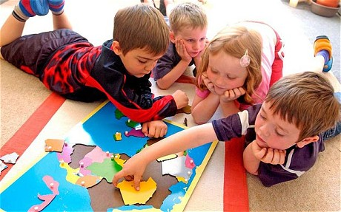
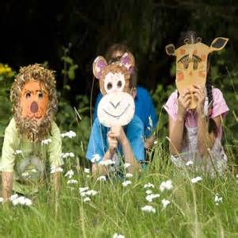
PLCs ARE ALL ABOUT THE STUDENTS WE SERVE EACH AND EVERYDAY.

Slide 6
Three Big Ideas
Learning for All
At the heart is a focus and a commitment to the learning of each student
Learning is a constant and everything else is a variable—time, resources, funding…..
A Culture of Collaboration
“A systematic process in which we work together, interdependently, to analyze and impact professional practice in order to improve our individual and collective results.” -DuFour, DuFour & Eaker
Educators can no longer function as if they are working in a one room school house...to much is changing for students and for us as educators.
Focus on Results
The basic premise is one in which we must produce dramatically improved results that identify students who need additional time and support.

Slide 7
Four Critical Questions
What is it we expect kids to learn?
How will we know when they have learned it?
How will we respond when they don’t learn?
How will we respond when they already know it?

Slide 8
WHY Professional Learning Communities?

Slide 9
Learning for all
Every Student Matters—they are our customers and the future
“Children are the gifts we send to the future—how shall we send them?”
Teachers are the cornerstone to effective learning and effective teaching in every classroom is critical to creating meaningful reform (Marzano, 2009).
Teaching is complex—development of instructional skills must continually be cultivated through collaboration and Prof. Development.
Present day accountability—”nothing ever improves if it is not followed by action.”
Action = SMART Goals, Guaranteed and Viable Curriculum, Common Formative Assessment, Collaborative Teaming, and Effective use of Data.

Slide 10
“Whereas many schools operate as if their primary purpose is to ensure that children are taught, PLCs are dedicated to the idea that their organization exists to ensure that all students learn essential knowledge, skills, and dispositions.” DuFour, Robert Eaker & Thomas Many; Learning by Doing

Slide 11
SPS District Mission Statement
The Sidney School District is a professional learning community with the mission of collaborating for the academic, emotional, and social growth of each student through quality and purposeful educational experiences in and out of the classroom. The District and community will share in the responsibilities of nurturing students along the path to thrive as productive life-long learners in a culturally rich world.
Challenge + Opportunity = Change
It may begin at home, but ultimately, it ends with us.

